Slide 1

MANAGE YOUR MEMBERSHIP
How to use MyLegion to view and manage Sons of the American Legion membership.
2026
Notes:
MyLegion is a secure website for American Legion and Sons of the American Legion members. View and manage membership information through MyLegion.org.

Slide 2
ABOUT MYLEGION
Notes:
MyLegion provides The American Legion and Sons of The American Legion members online access to their membership details and management tools. It also gives administrative officer’s tools for membership management and reports.
MyLegion allow members to renew online and set renewal preferences. Administrative officers of posts and squadrons can process membership online through their registered myLegion account.

Slide 3
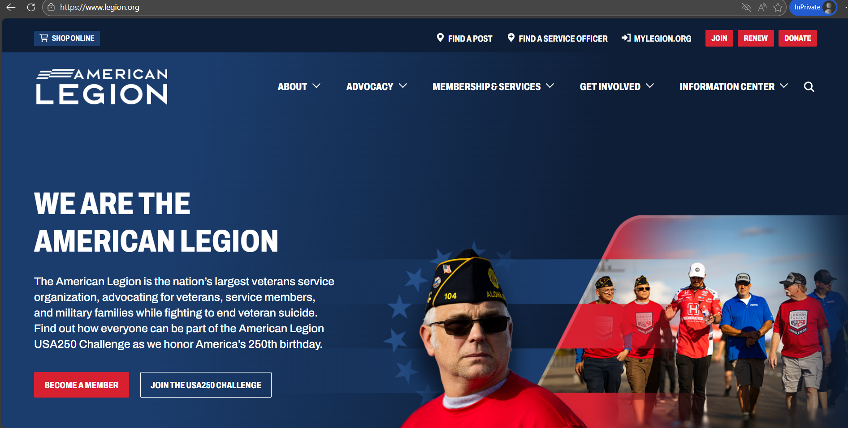

LEGION.ORG
Notes:
Access myLegion through The American Legion National website legion.org. Legion.org is a public site that provides contact information, American Legion available programs, services, and publications for The American Legion American Legion and The American Legion family.
Located at the top of the page is a link for MyLegion.

Slide 4
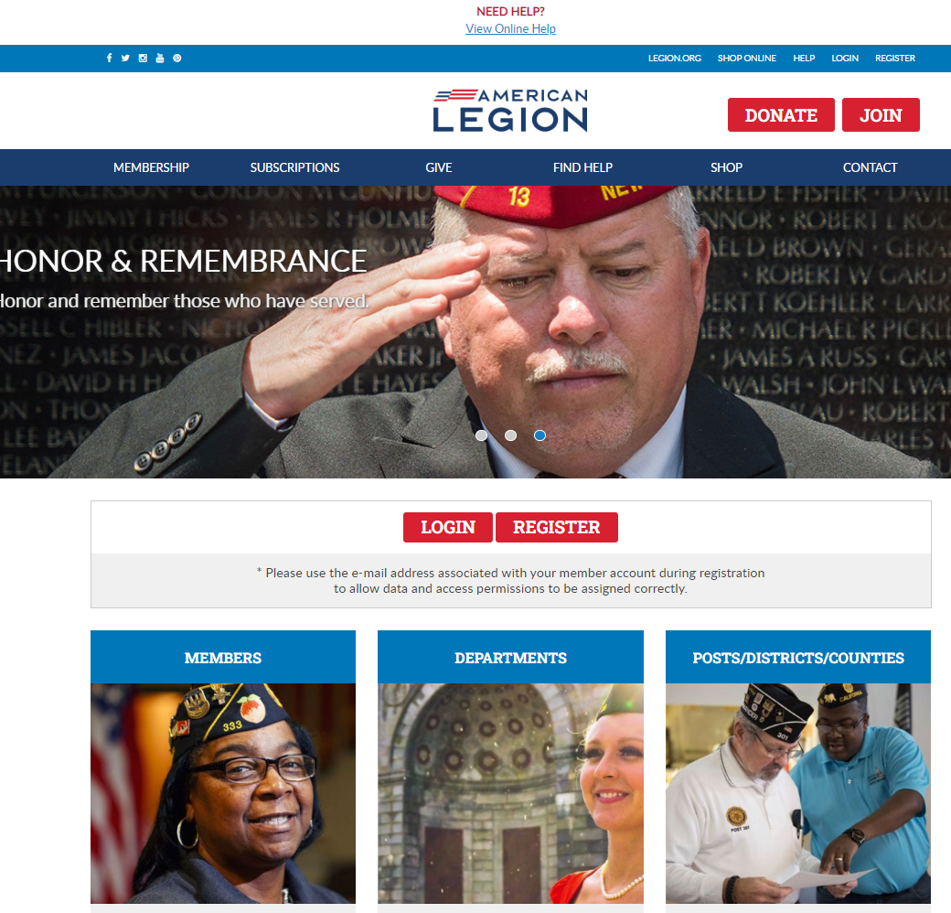

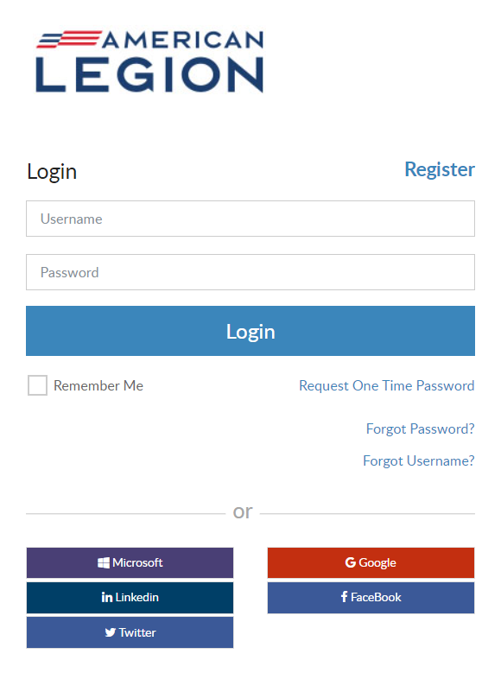
Log in or register a myLegion account to view and manage membership.
Notes:
Log In with your username and password. If you don’t have an account, click register to create one using the email address on your membership record.

Slide 5
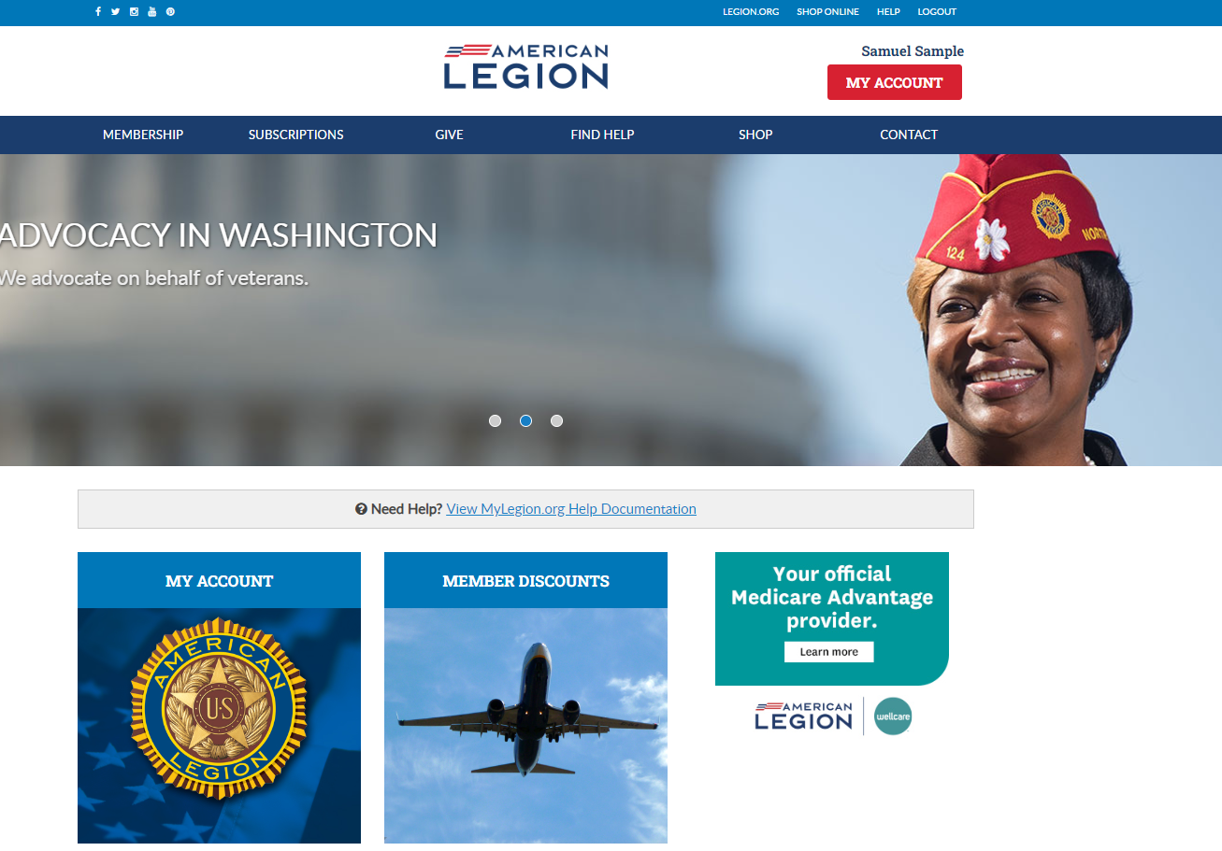
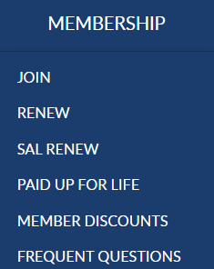
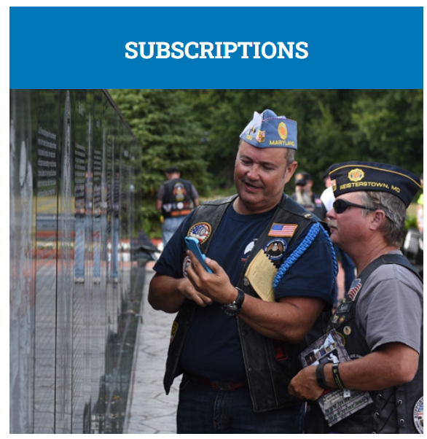
Notes:
From the MyLegion home page you will find menus that include links to membership, subscriptions, donations, help resources, Flag & Emblem and contact information.
Membership links for Sons include online Renewal and information about member discounts.

Slide 6
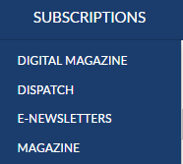
Notes:
Membership in The American Legion includes The American Legion Magazine in digital format from the Subscriptions menu, a link to monthly Dispatch articles and set up options for online E-Newsletters.

Slide 7
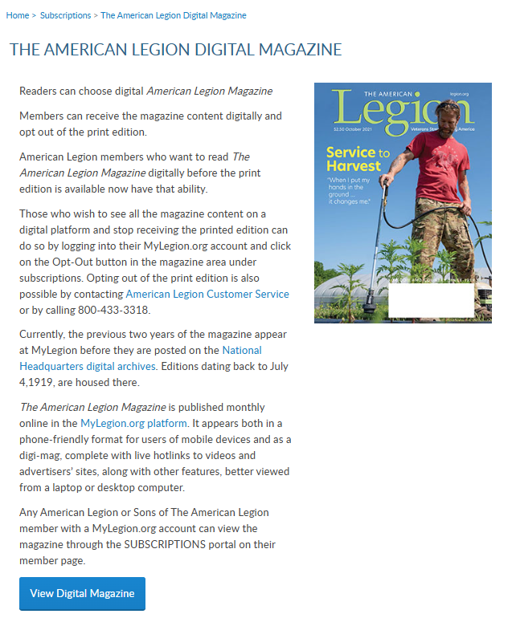
Notes:
Digital magazine provides contact information for national staff to assist with opting in and out of digital magazine subscriptions.
You will also find the link to request past publications through National Headquarters digital archives.

Slide 8
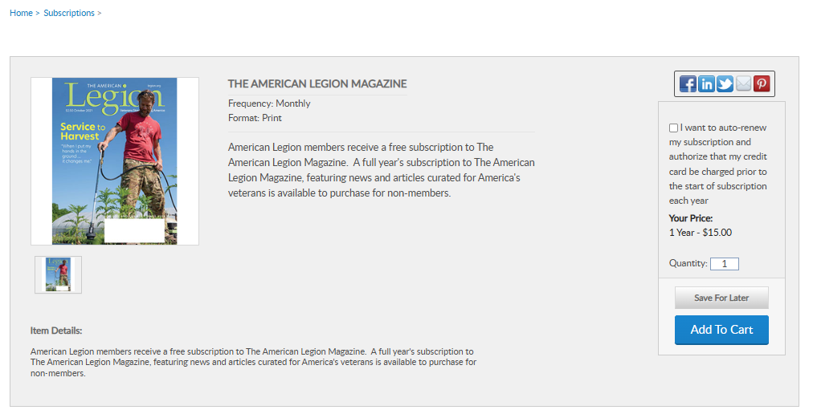
Notes:
The Magazine option at the bottom of the list provides a link for members of the Sons and non-members to purchase and renew their subscription. Members can purchase additional subscriptions.

Slide 9
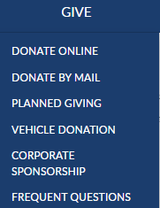
Notes:
Online giving opportunities can be set up through a MyLegion account. The give menu provides information about planned giving, vehicle donations and corporate sponsorships. Questions about giving to American Legion charities are answered in frequent questions.

Slide 10
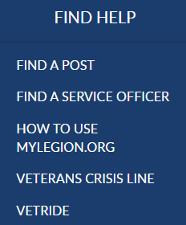
Notes:
Resources help you find a post or accredited service officers with step-by-step help documentation to assist with MyLegion tools for members and leadership. Links to veteran’s crisis line and Vet Ride are also available.

Slide 11
Notes:
The Shop link navigates to National Flag & Emblem and Contact re-directs to legion.org’s National HQ directory.
To view membership details and manage your account click on My Account.

Slide 12
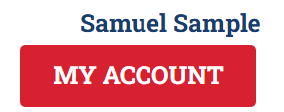
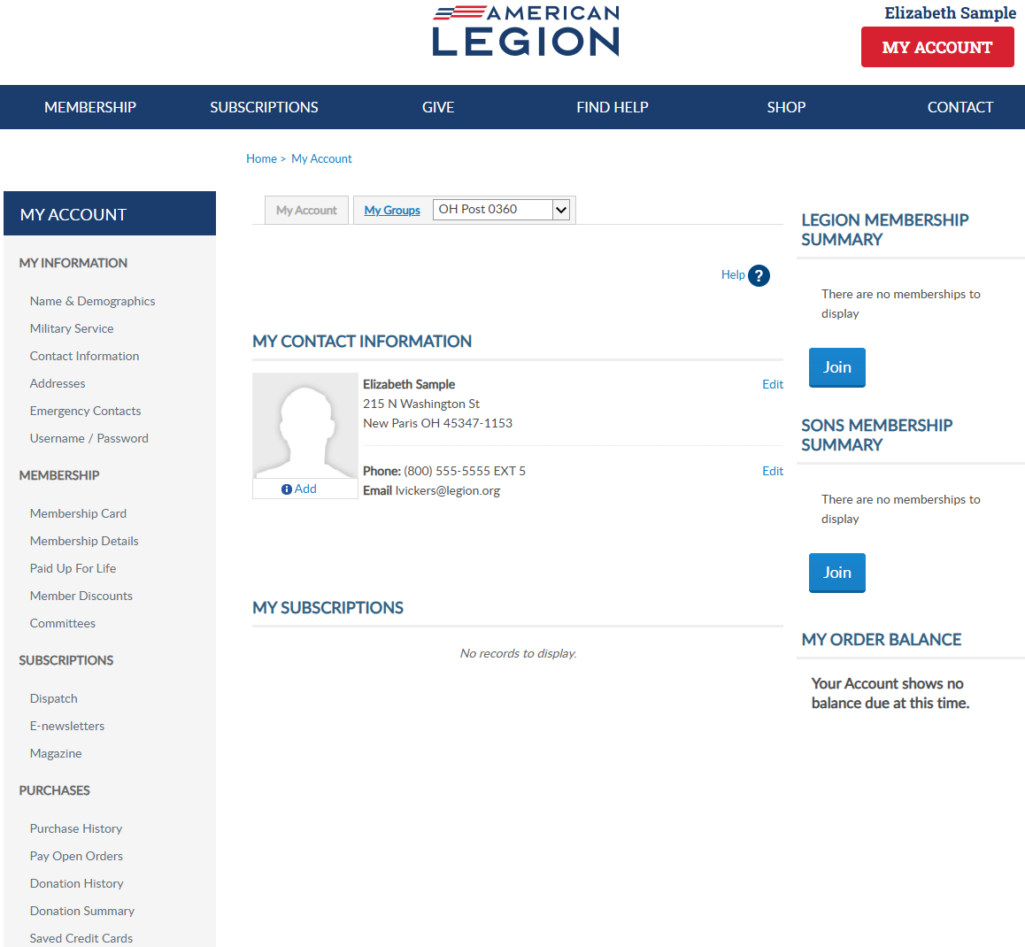
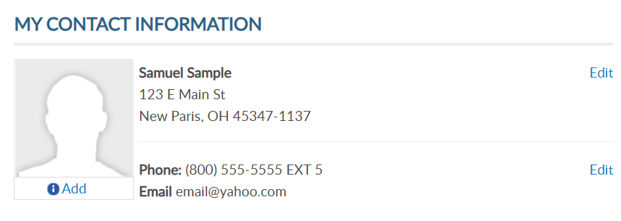
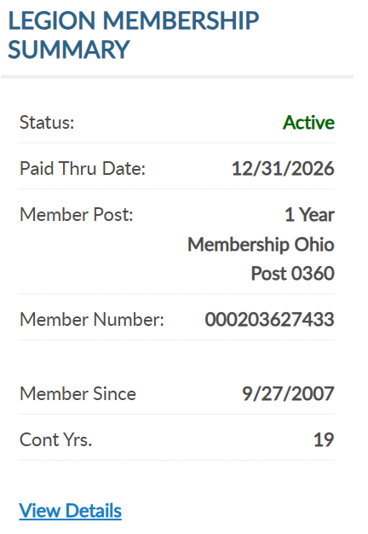
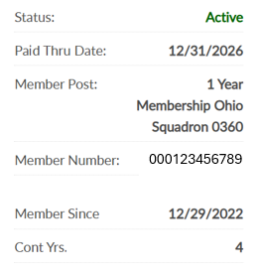
000123456789
Notes:
My Account provides membership detail summaries for American Legion and Sons of the American Legion membership. It include member status, renewal status, post and squadron number, member ID, join date and continuous years. <1> If you are a dual member, which is a members of both The American Legion and SAL you will see both membership summaries. Your member ID should be the same.
When a renewal is available the renew now button will display.

Slide 13
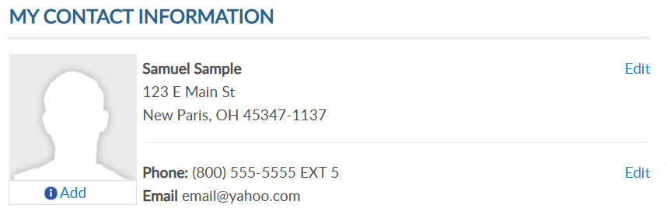
MY CONTACT INFORMATION
Primary Contact Information
Mailing Address
Phone Number
Email Address
Add Picture
Notes:
Primary contact information is located in the center of the page. You can also edit your primary mailing address, phone number and email address. You cannot edit your name in this area. Name updates can be made using the left menu option Name and Demographics.
This area allows you to add a picture that can be seen by local and state leadership and national headquarters staff.

Slide 14
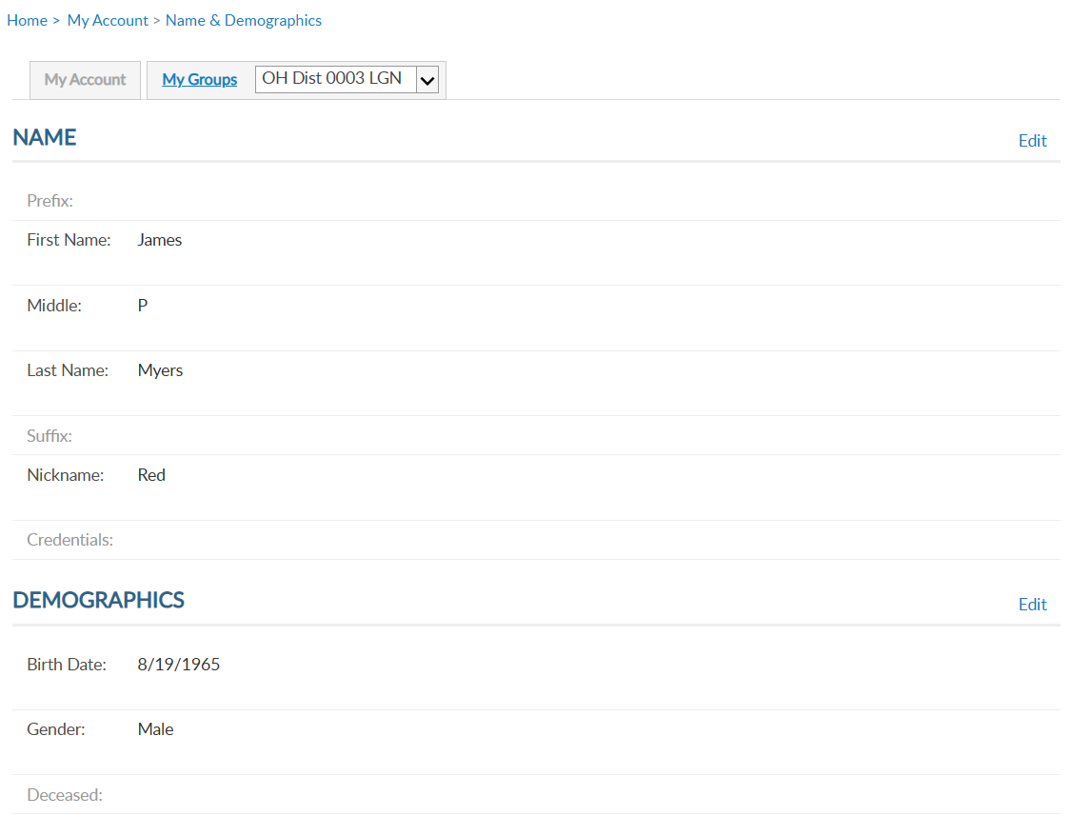
Samuel
Sample
01/01/1969
Notes:
MyLegion allows you to manage your name and demographic information. From the left menu, select Name & Demographics to open the window.
There are 2 sections in this area. Each has an Edit option. The name section includes prefixes, suffixes, nickname and title information. Let’s look at the demographics section. Click edit to the right of demographics.

Slide 15
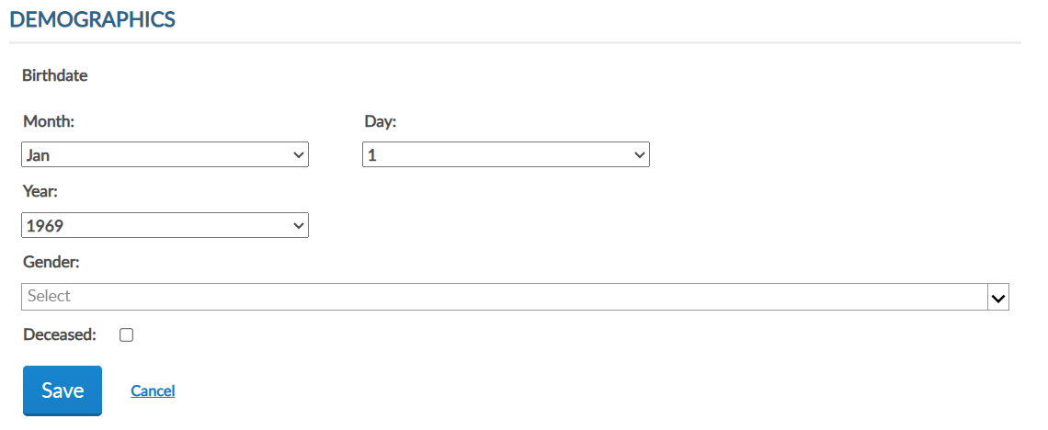
EDIT DEMOGRAPHICS
Notes:
Enter updates and save. Checking the deceased box will change member status to deceased. Deceased status will stop renewal notices, publications and subscriptions and end any committee assignments.

Slide 16
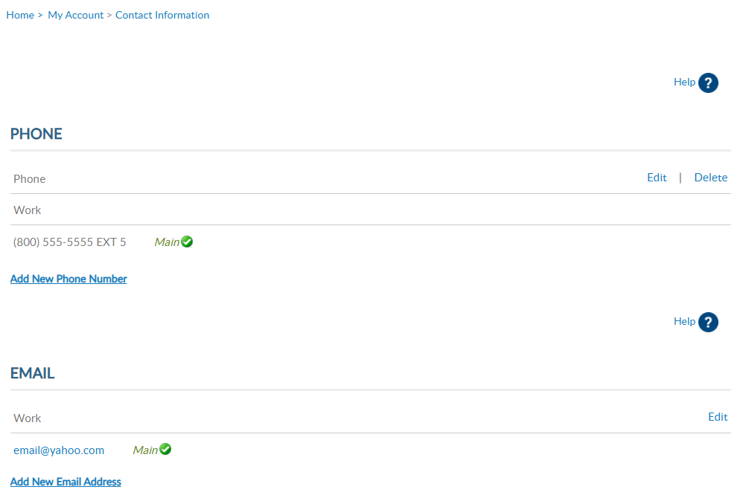

Notes:
Primary contact information can be done using edit in My Contact Information. To add or remove alternate phone number or email address you must use the left menu item Contact Information. <1>
Notice the current information is set to main. This is the contact information listed on leadership rosters and reports. Use the add, update and delete links to maintain your contact information.
Only one phone number and email are on file. All phone numbers and emails will display in this window. The email address does not have a delete option. Main email address information cannot be deleted. To update your email address, select the edit button. It is required to have a main email address on your membership record to have a MyLegion account.

Slide 17
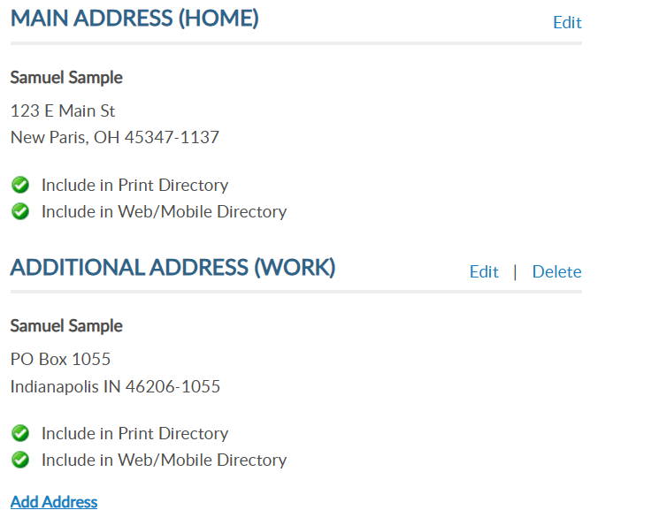
Notes:
Addresses allow you to add an alternate address and set address preferences. Information set as Main is the primary contact information and cannot be deleted.
Only one main contact can be assigned. You can add alternate address information for subscriptions and committee communications.

Slide 18
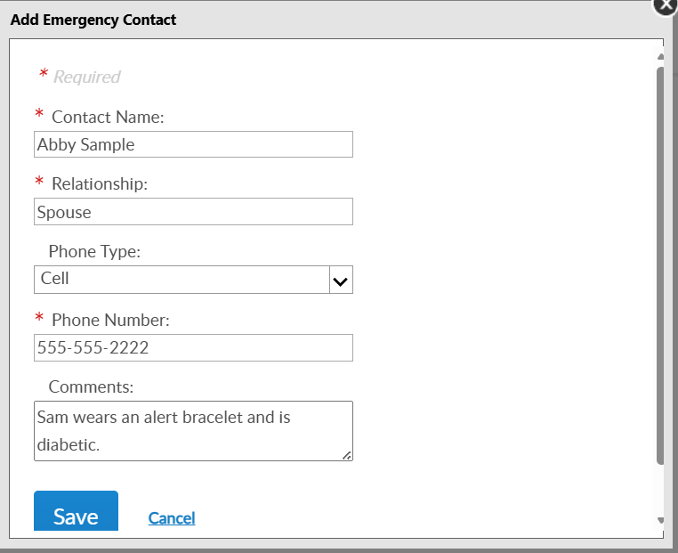
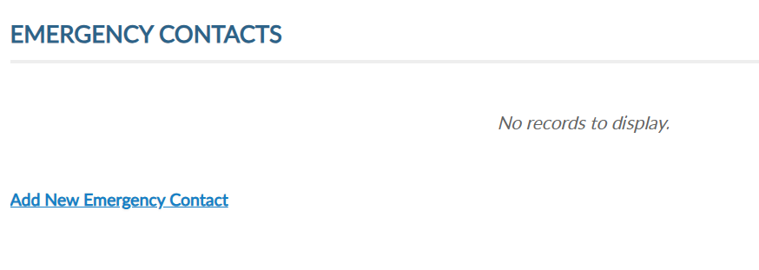

Notes:
Emergency contact information can be useful in case of an emergency if you are attending a convention, event, or visiting your local post.
Add single or multiple contacts and designate the priority of who to contact via phone. Click “Add New Emergency Contact”, enter data and save. <1>
You can add multiple contacts or delete/edit as needed.

Slide 19
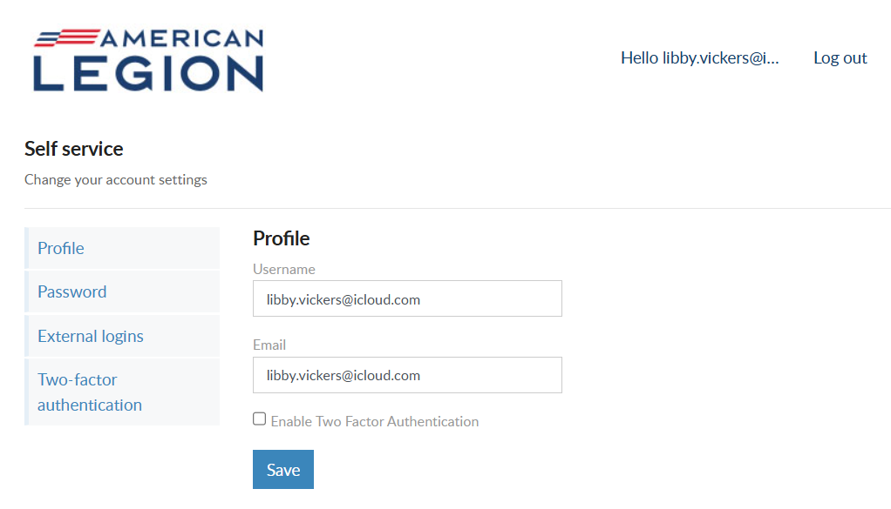

Notes:
Username/Password allows users to update log in credentials. This link opens a self-service window that shows your current username and primary email associated with your account.
Notice a new tab opens in your browser. After reviewing or updating information, close the tab to return to your MyLegion account.
Your account profile includes username and primary email address. MyLegion accounts are associated with the primary email address on file. Your username does not have to be an email address but is recommended.
The email address listed in the self-service window is the primary, or main email address. Updating the email in Username/Password directs all future forgot username and passwords to this email.
You can also enable or disable 2 factor authentication from this window. Enter new information and save.

Slide 20
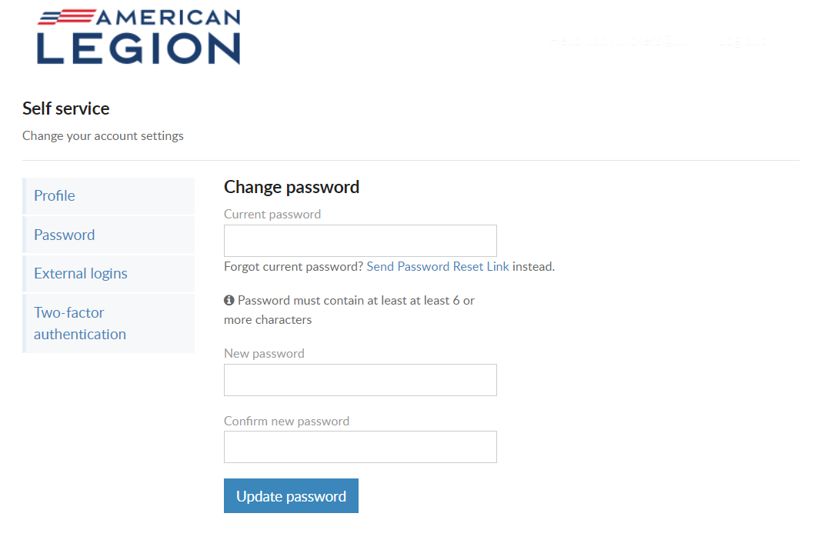
USERNAME & PASSWORD
Password
Current PW required
Must include:
1 Lowercase Alpha
1 Uppercase Alpha
1 Number
1 Symbol
8 Character Minimum
Notes:
To update your password in the self-service window you must know your current password. If you have logged in with a saved password and do not know it, use the “Send Password Reset Link” where a link will be sent to your primary email address.
If you know your current password, enter it with the new password and click ‘Update Password’.
Password requirements include: 1 Uppercase letter, 1 Lowercase letter, 1 Number, 1 symbol, and have an eight-character minimum.

Slide 21
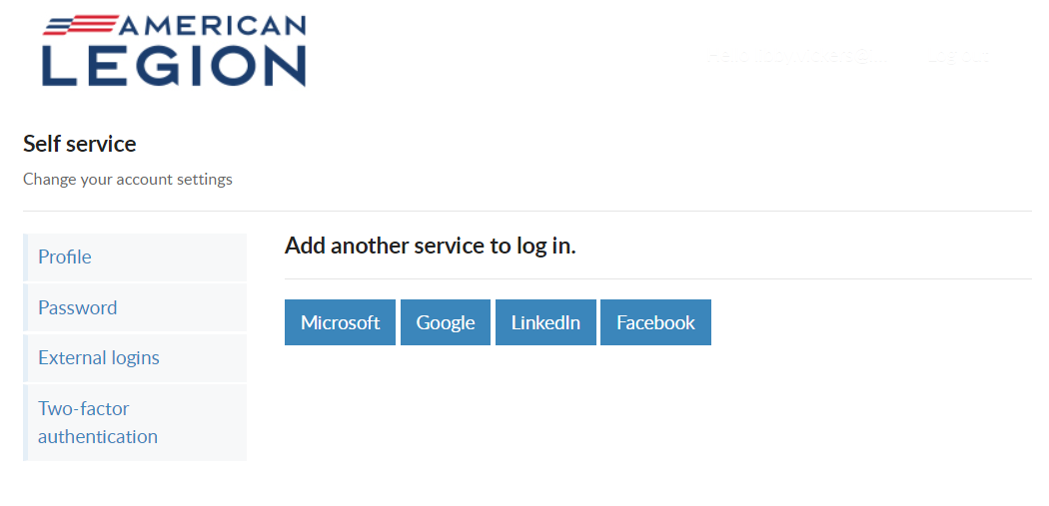
USERNAME & PASSWORD
External Logins
Notes:
Like many other web applications, myLegion users can log in using other online identities as a single sign on process. Allowing fewer passwords to remember.

Slide 22
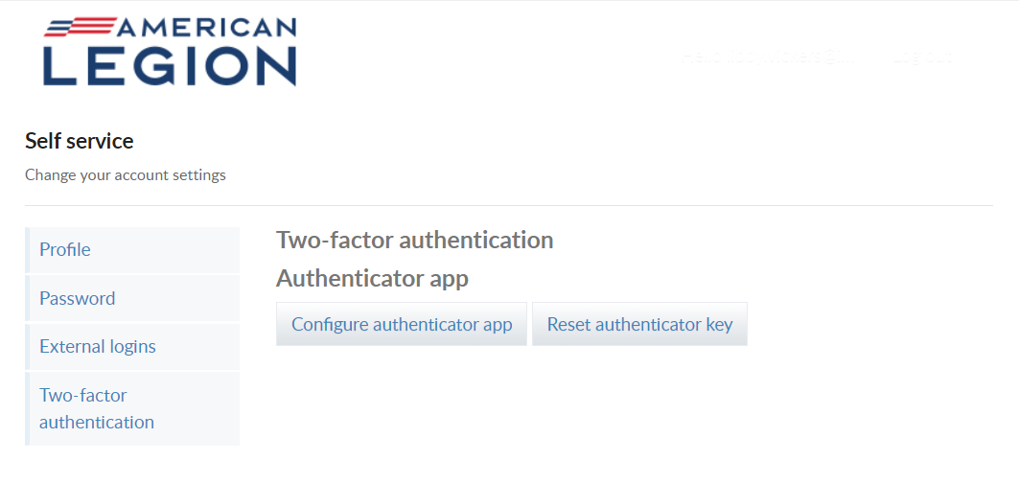
USERNAME & PASSWORD
Two-Factor Authentication
Notes:
Two-factor authentication is an extra layer of security to ensure that you're the only person who can access your account, even if someone knows your password. This extra security measure requires you to verify your identity using a randomized code we'll send you each time you attempt to log in.
If you set up 2 factor authentication, you can disable through self-service.

Slide 23

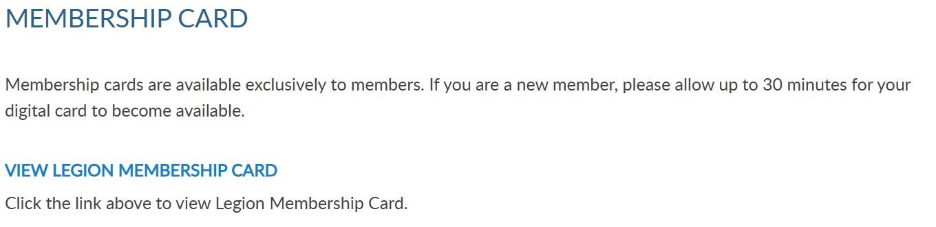


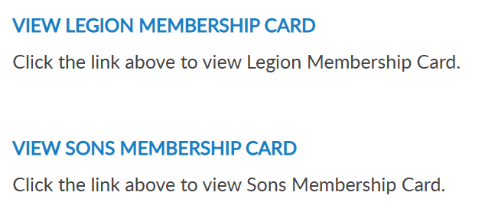
Notes:
To print your membership card, go to Membership Card
Legion and Sons of the American Legion membership cards can be printed. Only current membership cards are available. Click the link for the card to print.

Slide 24

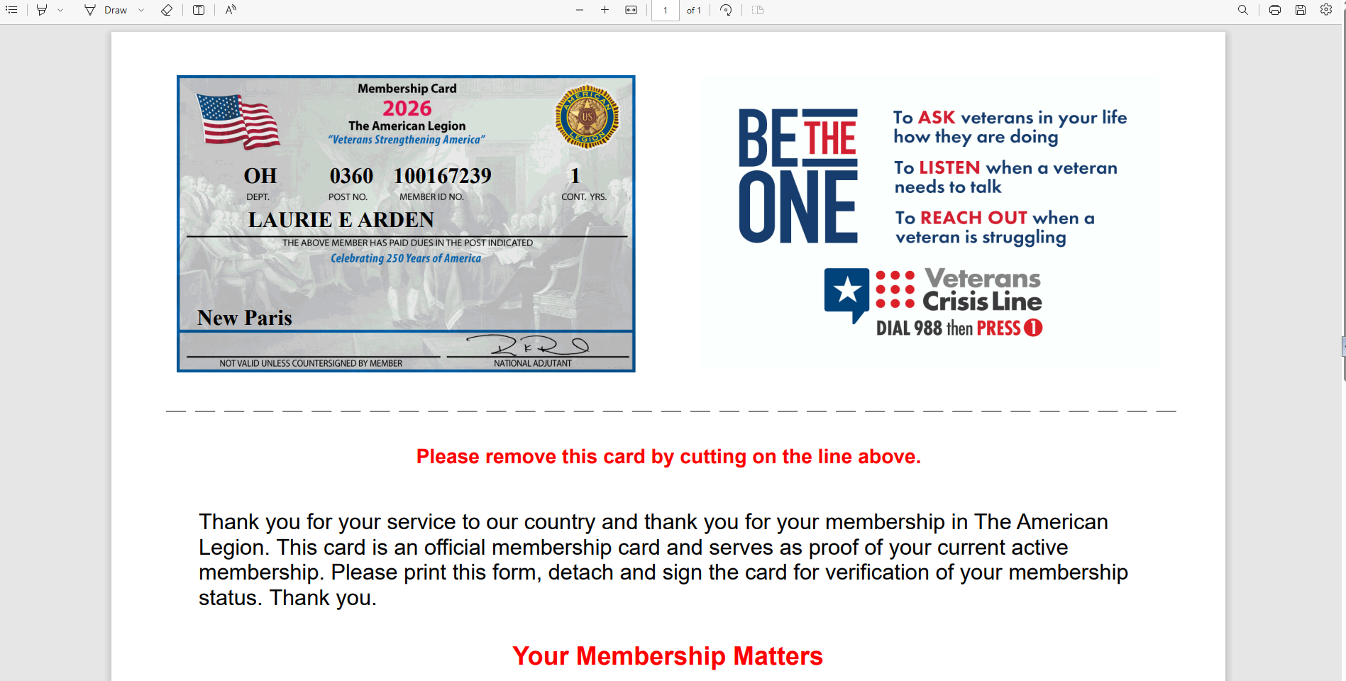
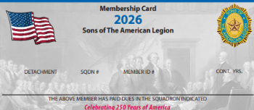
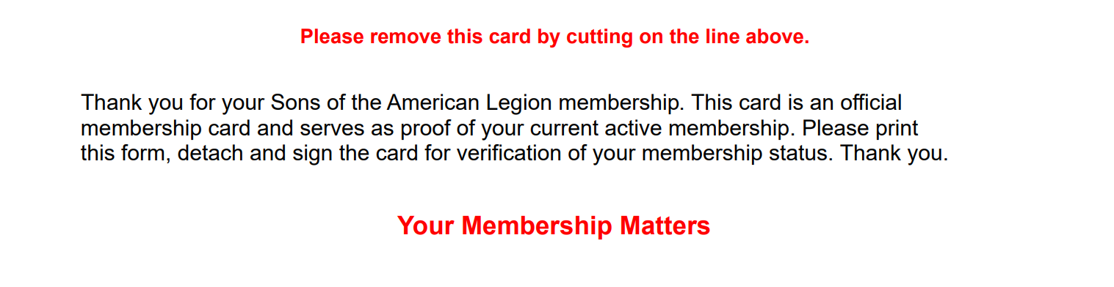
MEMBERSHIP CARDS
SAMUEL SAMPLE
OH 0360 123456789
4
Notes:
The card is available to print or save from your web browser. A pdf document will open in your browser to save or print.

Slide 25
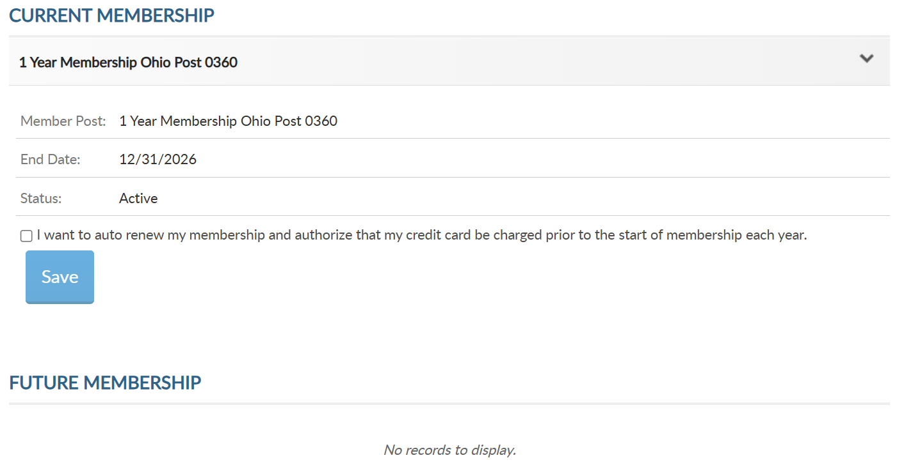

1 Year Membership Ohio Squadron 0360
1 Year Membership Ohio Squadron 0360
Notes:
View membership status and manage automated renewal in Membership Details.
MyLegion allows you to set up auto renewal. Members set up for auto renewal will have their credit cards charged and do not receive renewal notices. Auto renew is available for both American Legion and Sons of the American Legion members. You will have to set up each auto renewal separate if you are a dual member.
A credit card must be saved prior to setting up auto renewal. Credit card information is stored in Saved Credit Cards.

Slide 26
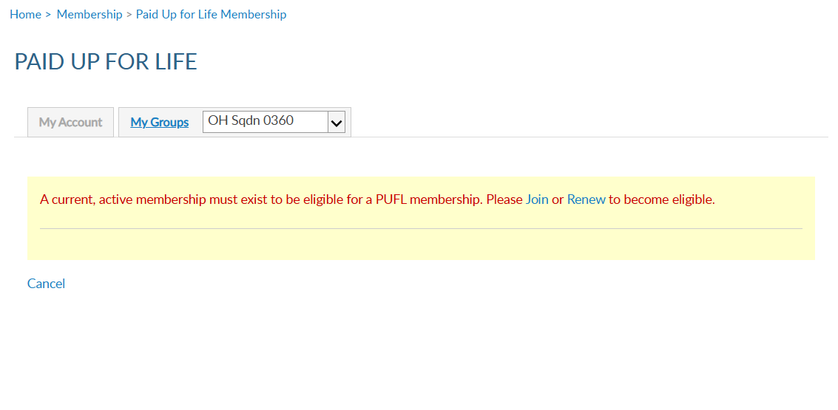

LEGION MEMBERS ONLY
Notes:
The Paid Up For Life is a program for Legion members only.

Slide 27
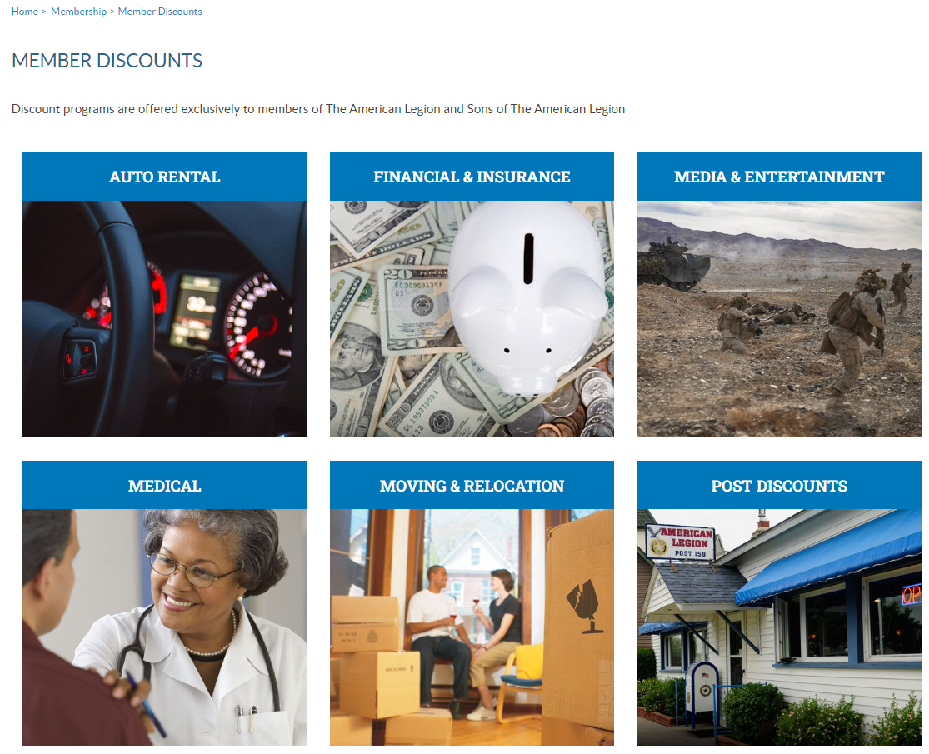

Notes:
The American Legion offers exclusive discount programs for members of The American Legion and Sons of the American Legion. Discount provider information and codes are only available to members.
Discount codes are found only when logged into myLegion or legion.org. Select the area of interest to view provider contact information and exclusive discount codes.

Slide 28
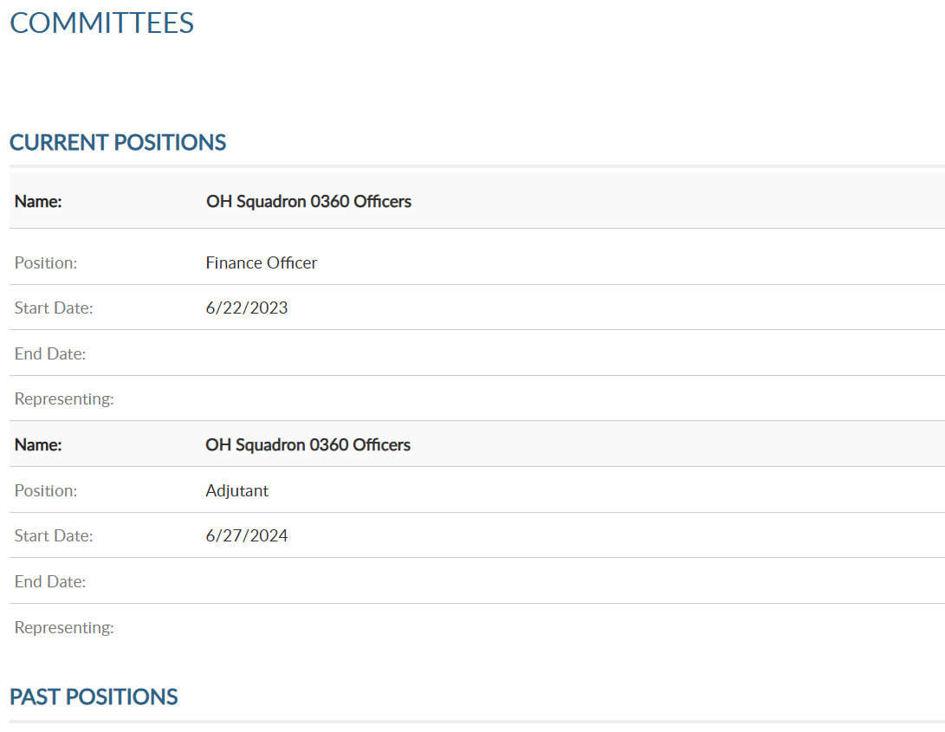

Notes:
Committees list current, future and past positions reported to national headquarters. Missing information regarding your officer history can be clarified through your department headquarters.

Slide 29
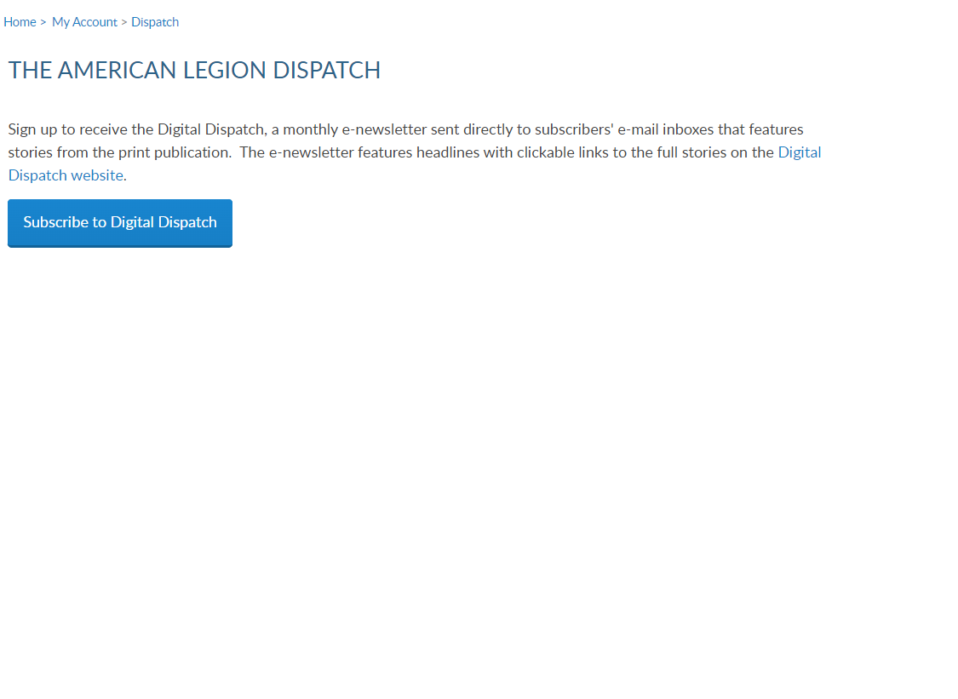
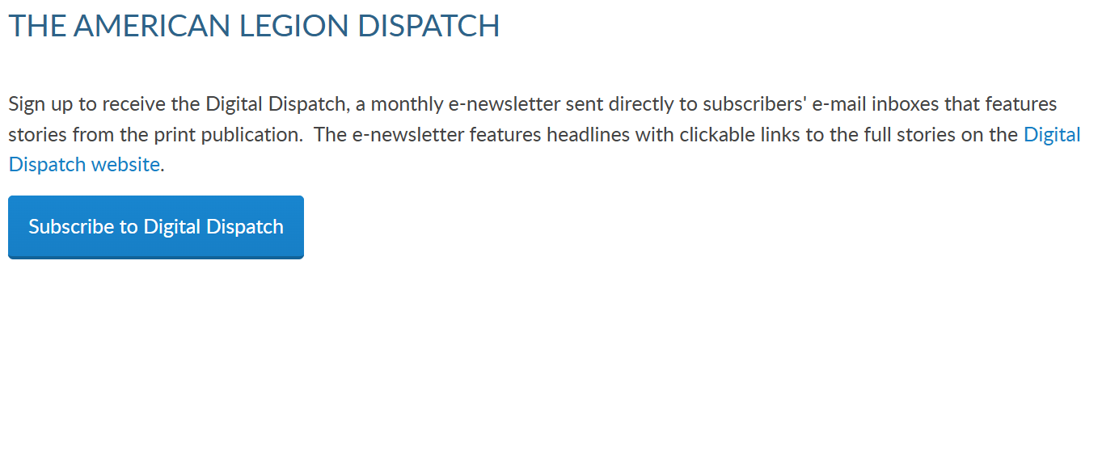
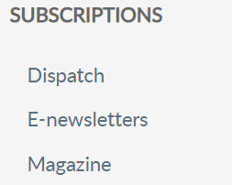
Notes:
Dispatch is an American Legion National Headquarters monthly online newsletter that provides post, district and department leaders with news relevant to membership, post activities and national American Legion news.
A monthly Digital Dispatch e-newsletter is sent directly to subscribers’ email inboxes. The e-newsletter features headlines with clickable links to the full stories on the Digital Dispatch web page, www.legion.org/dispatch.

Slide 30
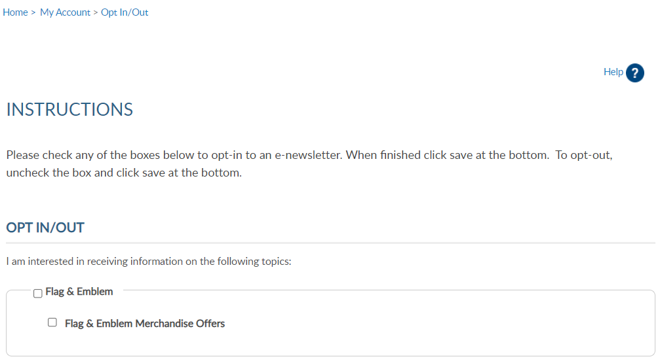
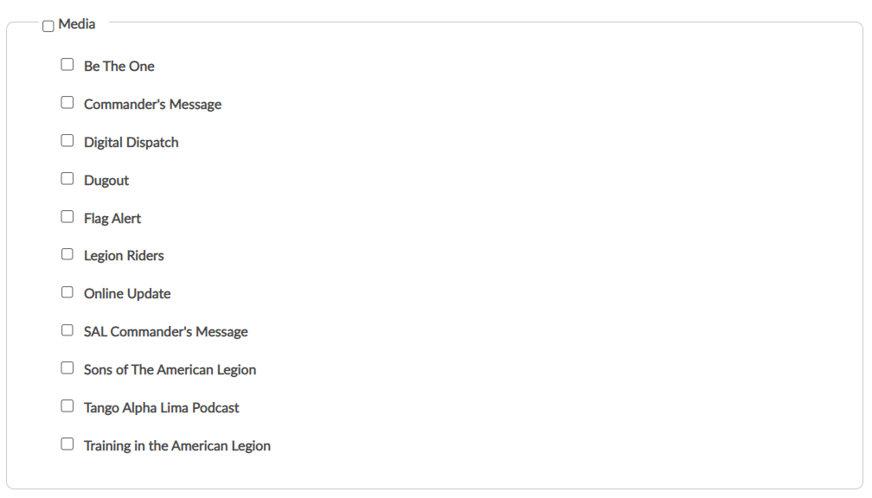
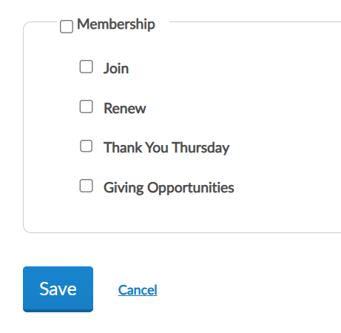
Notes:
E-newsletters allows you to opt in or out of online subscriptions. <1> There are 3 sections. Flag & Emblem, Media, and <2> Membership.
Check the box to select individual subscriptions. <3> Unless specified these subscriptions will be emailed to the main email address on file.
Once all options are selected, save changes.

Slide 31
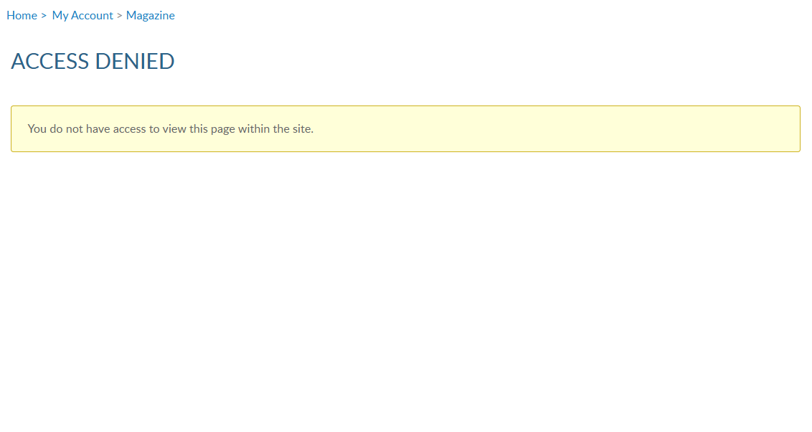
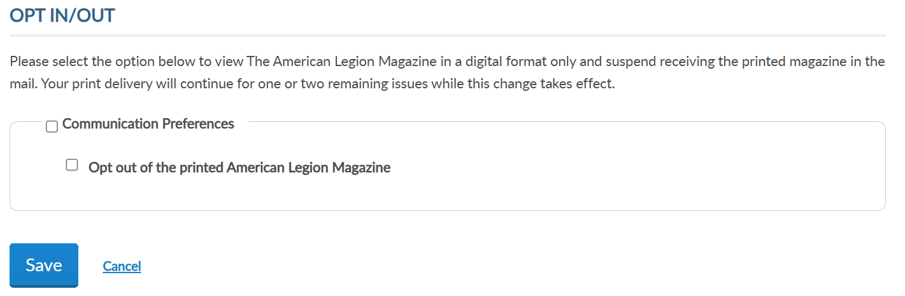
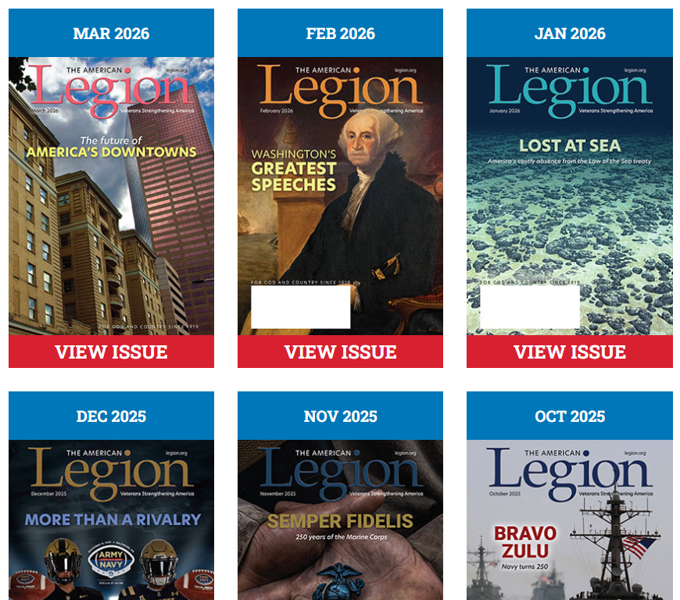
TAL Magazine issues are included with only Legion membership.
Notes:
SAL and TAL expired members will receive an Access Denied message. Access to online magazine requires active American Legion membership, or paid subscription.
Legion members receive a 12-month free subscription to The American Legion Magazine. This publication has gone digital. Current and past issues for 2 years are in your My Account subscriptions menu. To view past issues, go to archives using the upper menu Magazine option.
NOTE: Why doesn’t SAL include magazine? National per capita dues for SAL are only $5. Nat’l per capita would have to increase to add the benefit.

Slide 32
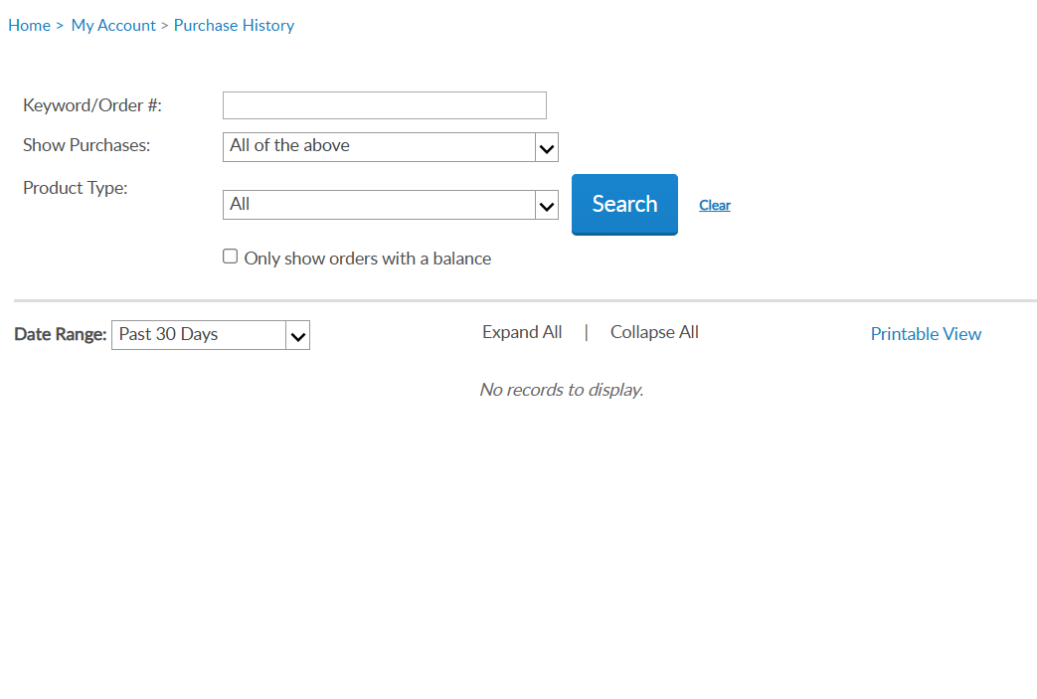
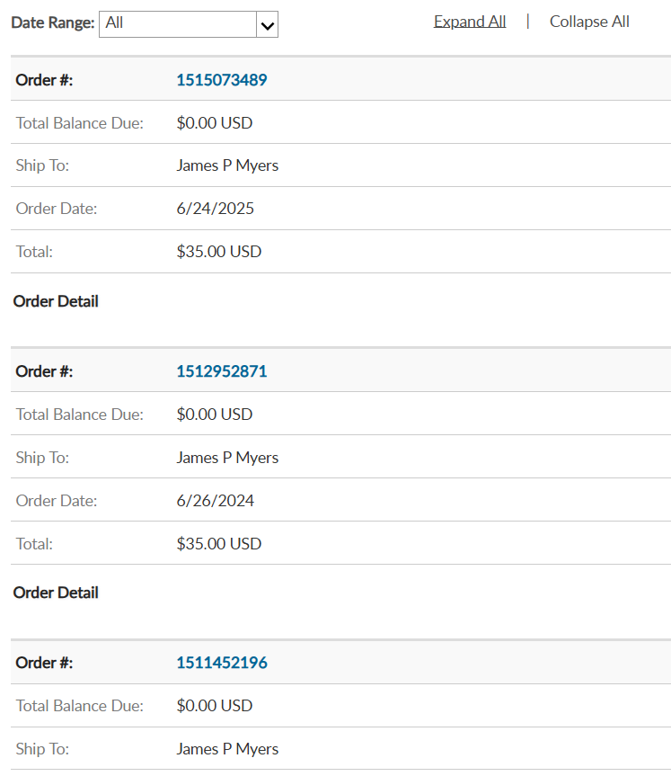
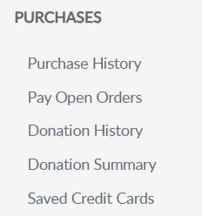
Samuel Sample
Samuel Sample
Samuel Sample
Notes:
Purchase history shows current open orders and history of payments made for membership and subscriptions. <1> Expand the date range to view past payments.

Slide 33
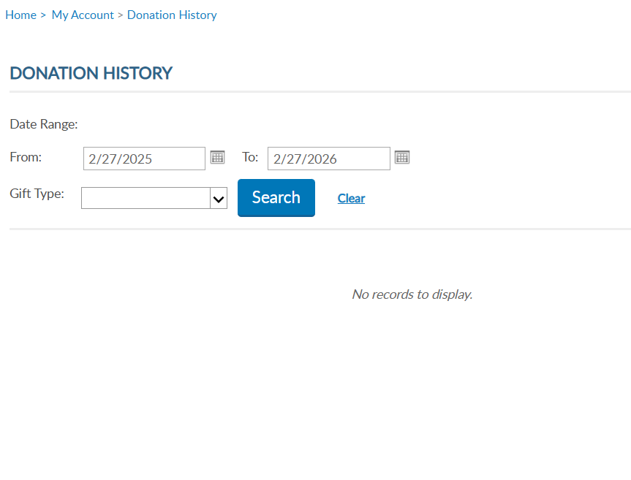
Notes:
Donation history provides a date range search to view donations made to American Legion Charities.

Slide 34
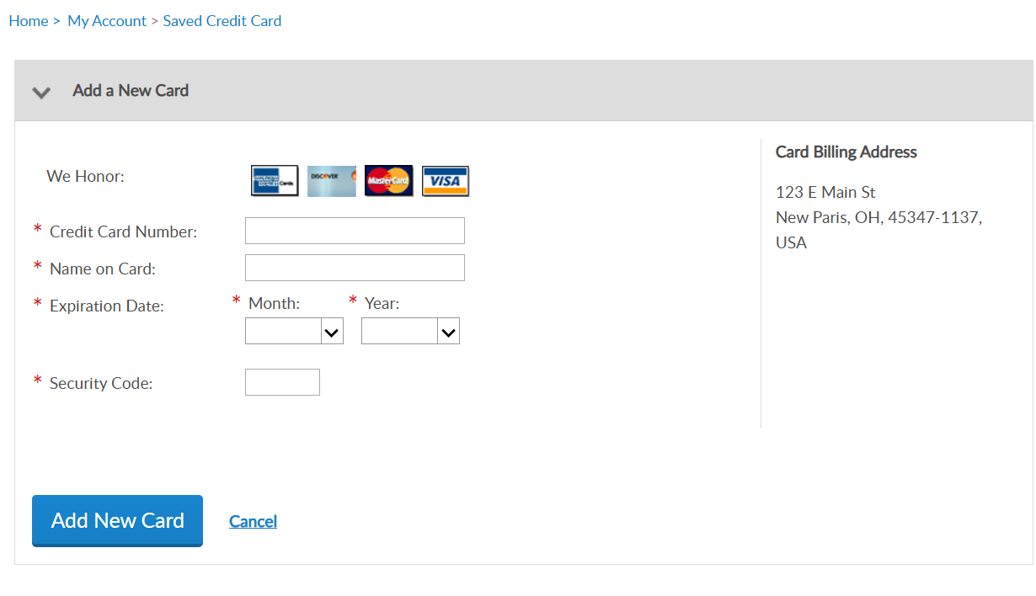
Notes:
Members can enter, maintain, and save credit card information for auto renewal, donations, and purchases.
<1> If not card is stored you can add a new card. <2> Go to add New Card, enter card information and Save. <3>
At any time, you can update, remove or add another card.

Slide 35

MY ACCOUNT & HELP RESOURCES
Notes:
Learn more about MyLegion using “Find Help” and go to How to use MyLegion.org.

Slide 36

Online Help
Notes:
Step by step instructions, videos and training presentations will assist with how to manage your member account and groups in MyLegion.

Slide 37
MYLEGION SUPPORT
MyLegion@legion.org
833.253.9995
Monday – Friday
8:00am – 4:30pm
(Eastern)
The American Legion National HQs
5745 Lee Road
Indianapolis, IN 46216
Contact your MyLegion support team to assist with any questions or tools on your MyLegion account.
Notes:
Contact your myLegion support team to assist with questions and tools for MyLegion. Email mylegion@legion.org or call 833-253-9995 Monday through Friday.

